Slide 1
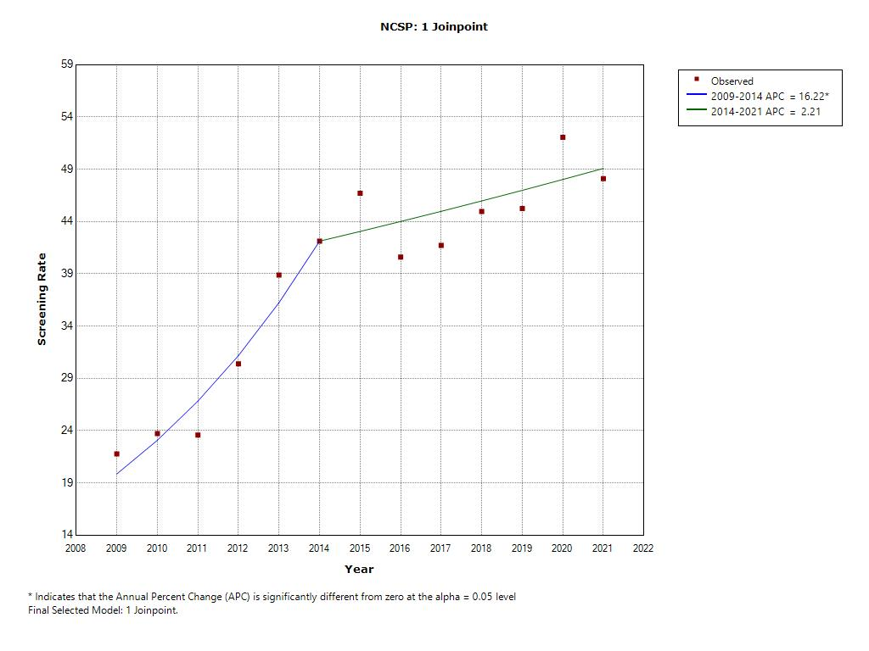
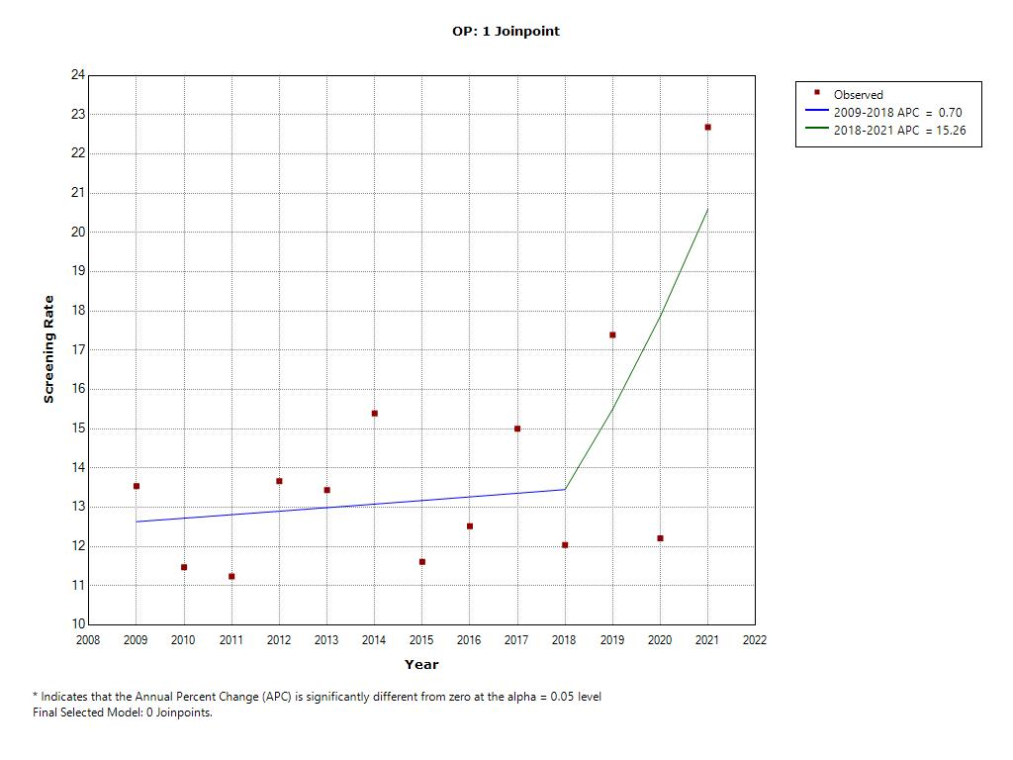
A
B
Supplementary Material 1 . Trends in organized (A) and opportunistic (B) colorectal cancer screening from 2009 to 2021.
*Indicate that Annual Percent Change (APC) is significantly different from zero at the alpha level=0.05

