Slide 1
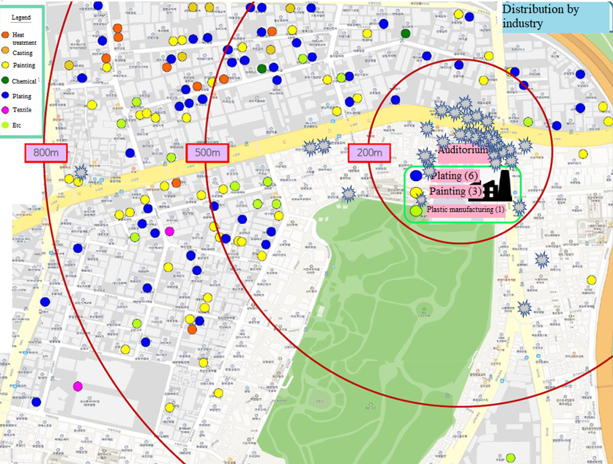
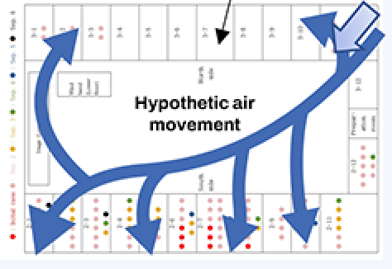
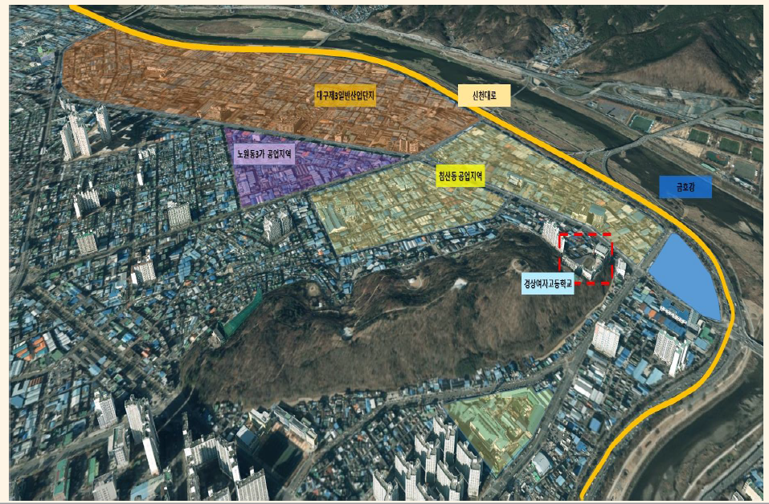
The hypothetic air movement of puff gas in the auditorium on that day, considering the wind direction of the time, the location where a similar odor was sensed, and dot mapping of auditorium.
Potential location of
causative agent
emission, estimated by
our research team

