Slide 1
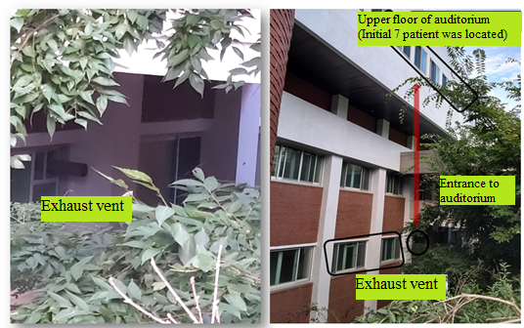
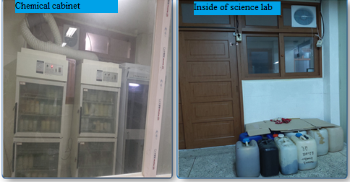
Inside and outside photos and floor plans of the school science lab. Location of the external exhaust vents of the science room and auditorium was shown.

