Slide 1
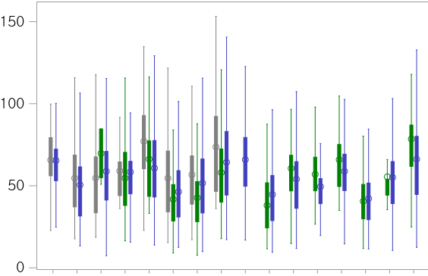
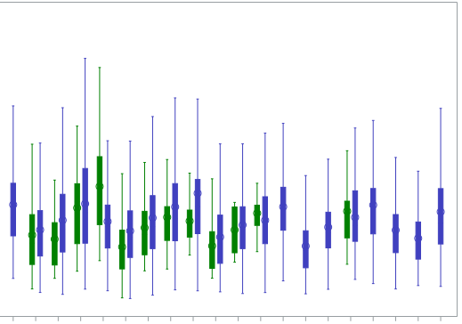
Supplementary Material 6
PM₁₀, µg/m³
Season Sp S F W Sp S F W Sp S F W Sp S F W Sp S F W Sp S F W Sp S F W Sp S F W Sp S F W
Year 2005 2006 2007 2008 2009 2010 2011 2012 2013

